Slide 1
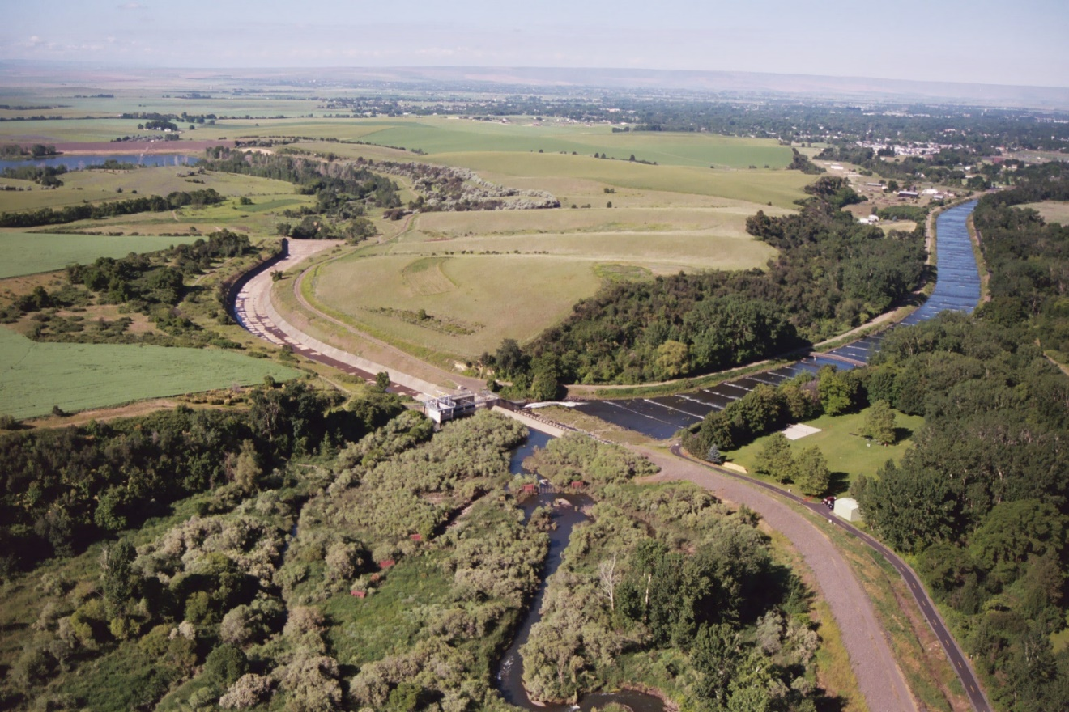
Economics

Slide 2
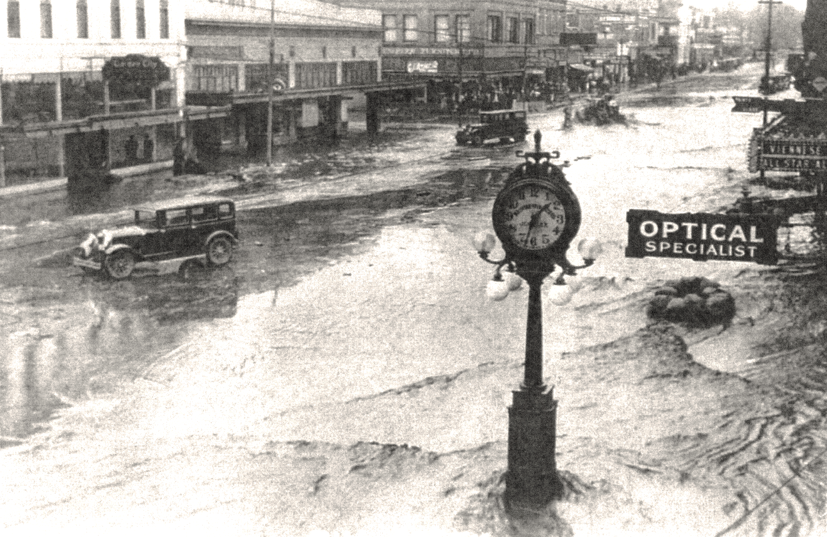
1931 Flood

Slide 3
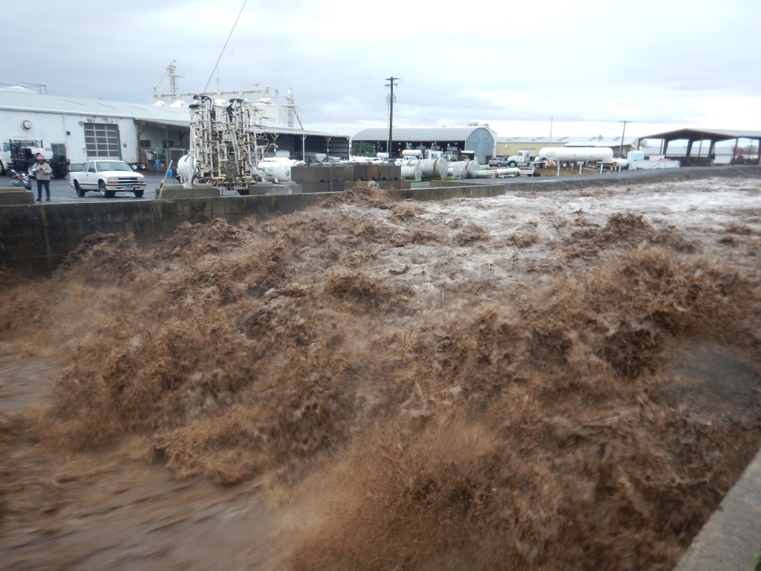
2020 Flood

Slide 4
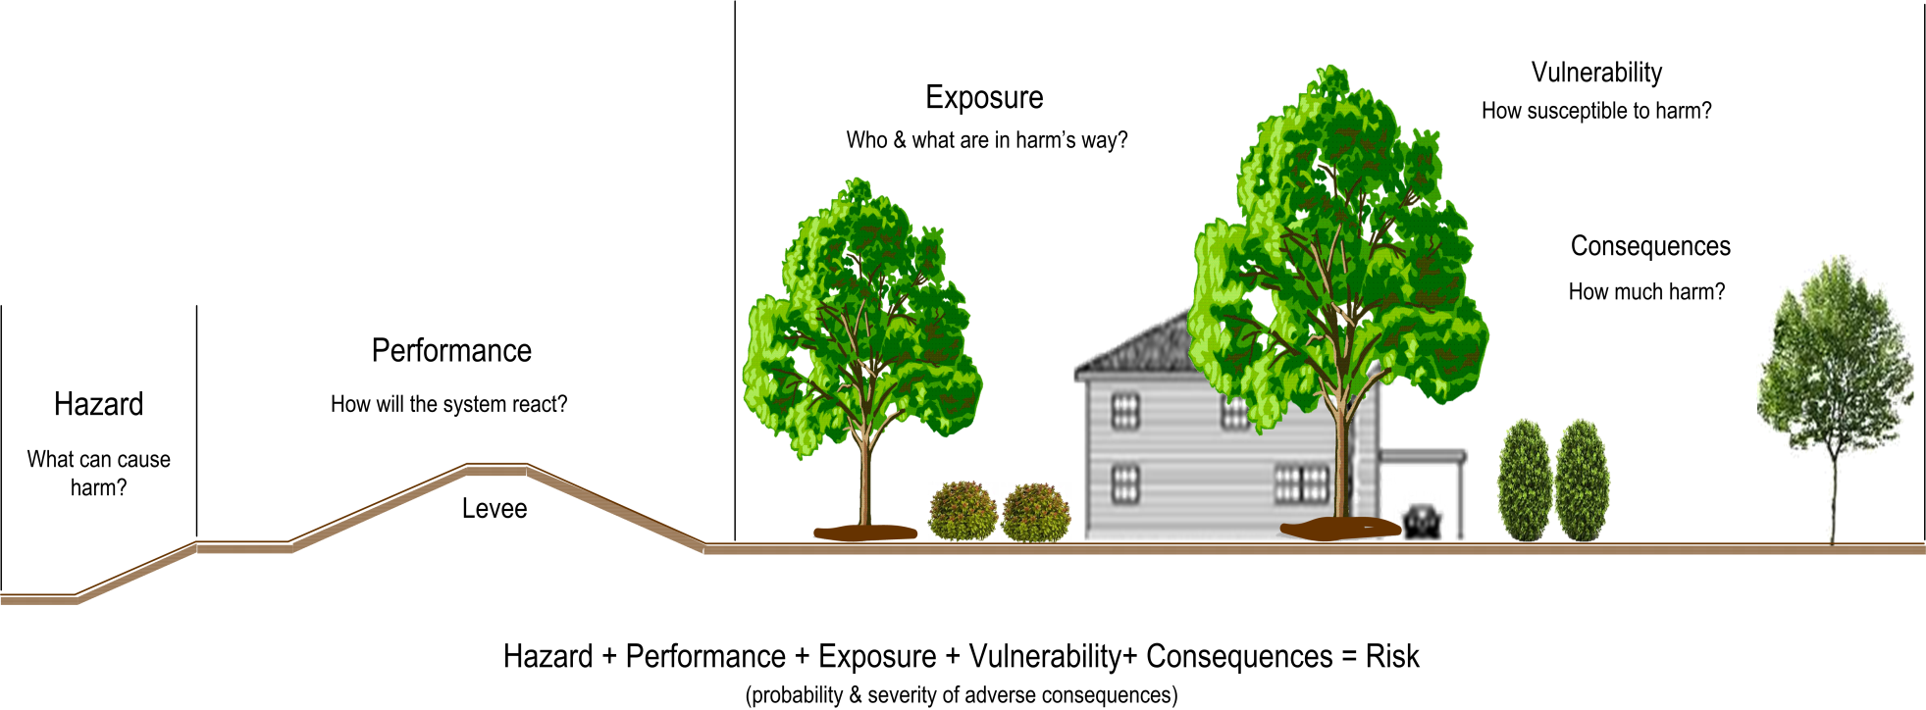
Risk

Slide 5
2020 flood: regulated flow
feet
feet

Slide 6
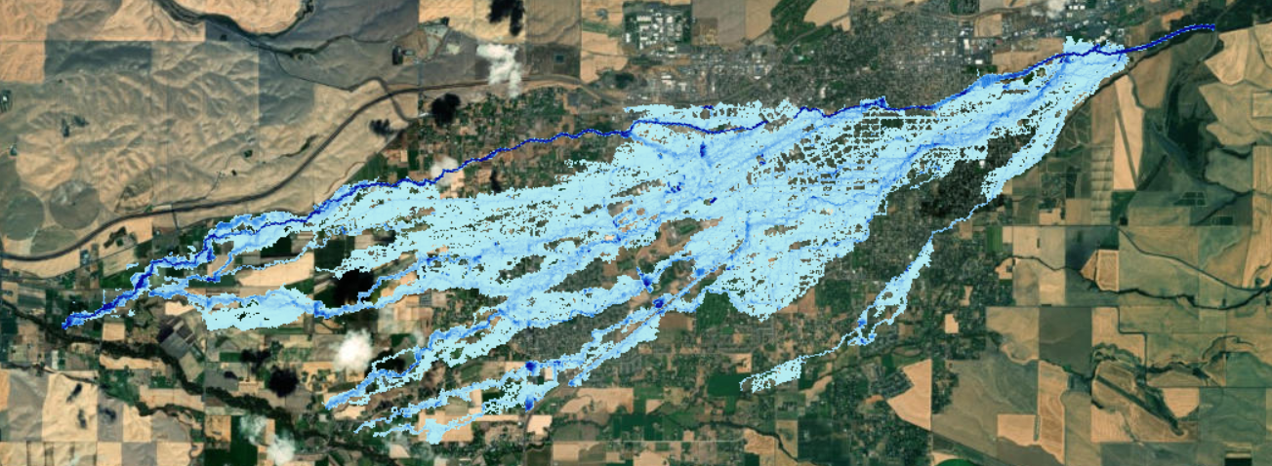
2020 flood: peak flow without regulation
feet
feet

Slide 7
Tentatively selected plan
 | Estimated First Cost of Construction | Average Annual Cost | Average Annual Benefit | Benefit Cost Ratio (BCR) | Net Annual Benefit
Levee Raise Channel Rehabilitation Modify Project Operations Buyout/Acquisition | $9,928,000 | $345,000 | $532,000 | 1.54 | $187,000

Slide 8
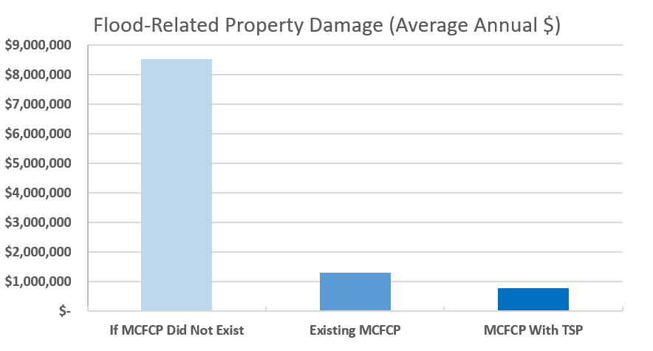
Flood-related property Damage
What if we did not have the Mill Creek Flood Control Project?
Does the Mill Creek Flood Control Project eliminate all flood risk?
What does the Tentatively Selected Plan do for existing flood risk?

Slide 9
Flood preparedness
Planning Objective: Reduce flood-related damages and economic consequences to the community of Walla Walla.
What can you do to reduce your risk of flood-related property damage?
Planning Objective: Reduce risks to public safety and public and private infrastructure due to flooding along Mill Creek
What can you do to reduce your risk of being harmed in a flood?

Slide 10
